Slide 1


Integrity challenges in McEwan’s Solar:
Novels on research integrity in the era of big science In research and education
Prof. Dr. Hub Zwart
RU Nijmegen – Faculty of Science – Institute for Science, Innovation and Society (ISIS) – Department of Philosophy and Science Studies
This project has received funding from the European Union’s Horizon 2020 research and innovation programme under grant agreement No. 665926.

Slide 2

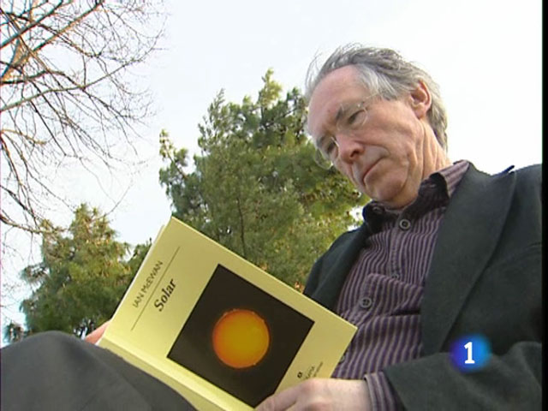
2010

Slide 3
Three Dimensions (Foucault)
Knowledge: scientific plagiarism connected with new forms of knowledge and knowledge production
Power: plagiarism reflecting power relationships in contemporary research
Ethics (the Self): how academics (fail to) constitute themselves as responsible subjects vis-à­-vis integrity challenges emerging in contemporary research practices

Slide 4
Narrative: the power dimension
A second-half-of-life academic who (notwithstanding prominence and fame) has lost interest in / contact with his area of research and ‘solves’ his problem through abuse of power, by committing (and concealing) acts of plagiarism.
The victim is a young post-doc, exploited by a research manager on whom he is completely dependent for his future career
Plagiarism, committed by a wealthy powerful professor at the expense of hard-working early stage researchers

Slide 5
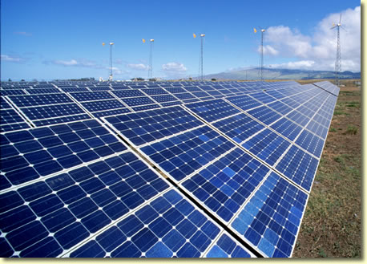
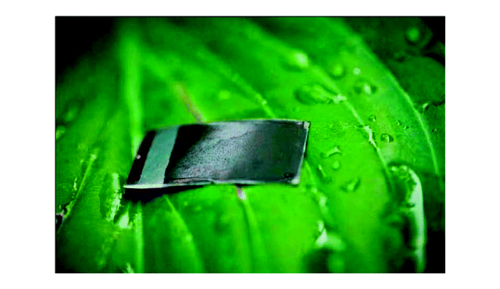
Research Fields
Quantum physics (photovoltaics)
Nanotechnology (nano-solar)
Artificial photosynthesis
Climate change and solar energy (industrial scale)
Convergence

Slide 6
Diagnostics: Knowledge
Let the philosophers of science delude themselves to the contrary, pure physics was free of human taint…
Science moving from pure science to big science (large-scale research, heavily funded, big expectations) where research becomes entangled with politics and policy agenda’s, industry (“plutocrats”, funding agencies, investors, venture capitalists, managers, international policy makers, international media)
Power relationships and integrity challenges involved

Slide 7
Michael Beard in Solar
Beard-Einstein Conflation
Scientific Director of the newly established National Centre for Renewable Energy
LAPP: the Lordsburg Artificial Photosynthesis Plant), New Mexico
Artificial photosynthesis: mimic (plagiarise, copy-paste) the basic molecular processes of life

Slide 8
Plagiarism is the default
“Climate change has generated … an epic story with a million authors … building on archetypal scripts: communal re-creation”
Plagiarism is the default, acknowledgement the exception
it is difficult not to plagiarize, we are plagiarizing continuously (consciously and unconsciously)
Virtue is a weak force

Slide 9
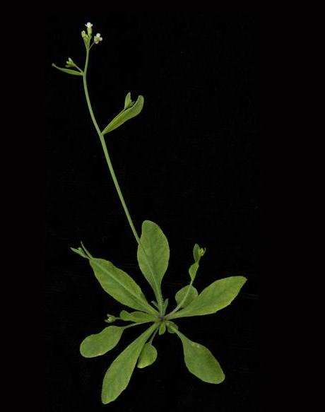
Biomimesis
Reverse engineering photosynthesis
Plagiarizing nature
Discover, then copy the ways of plants, perfected by evolution during three billion years
Your humblest pavement-crack weed has a secret that the best dozen labs in the world are only just beginning to understand
The leaf as a kind of solar panel

Slide 10
Second half of life
“Beard had coasted all his life on an obscure young man’s work, a far cleverer and more devoted theoretical physicist than he could ever hope to be... That twenty-one-year-old physicist had been a genius. But where was he now?”
“So long ago, so hard to recall the driven kind of person he once was...”
“Youth: a brief state of grace; those blessed months of frenetic calculation. What a feat of concentration!”
After midlife: restless boredom, overweight, alcoholic, lack of self-discipline, spoiled, lazy, etc. (‘He had done no serious science in years’)

Slide 11
Plagiarism?
Tom Aldous, with a head exploding with ideas… But, Beard was the one who had seen the true value of Tom’s work, doing the hard work, securing patents, assembling a consortium, progressing the lab work, involving venture capital. And details of surnames were hardly relevant when the issue (climate change) was so urgent...

Slide 12
Self-exploitation
Beard in Solar has burnt himself out, he has emptied himself, and this relentless self-exploitation now fires back at him
Beard has lost track of his former Self, his scientific “other half”, his prolific counterpart
He is and is not the quantum physicist he once was. He is and he is not a plagiarist. He is unable to conflate both positions into a coherent wholeness (integrity).
Plagiarism to compensate for the loss of his former Self (psychic conflation)

